Slide 1
Support Vector Machines
And anti-gravity cows
Lecture 13

Slide 2
Before We Begin
You'll want the dates.csv dataset downloaded (on Canvas)
Assignment 3 due a week from today

Slide 3
Friday, September 13th
International Chocolate Day
National Peanut Day
Roald Dahl Day
Programmers Day

Slide 4
Lecture Resources
https://towardsdatascience.com/support-vector-machine-simply-explained-fee28eba5496

Slide 5
Heads Up
This is a cool technique
With a lot of math in the background
Most of which we are basically going to hand-wave away
Please try and stay awake

Slide 6
Let's start with a very simple example
You have sheep
You have cows
You have one fence post
You want to keep your sheep as far away from your cows as possible
Because they like to plot together to take over the farm

Slide 7
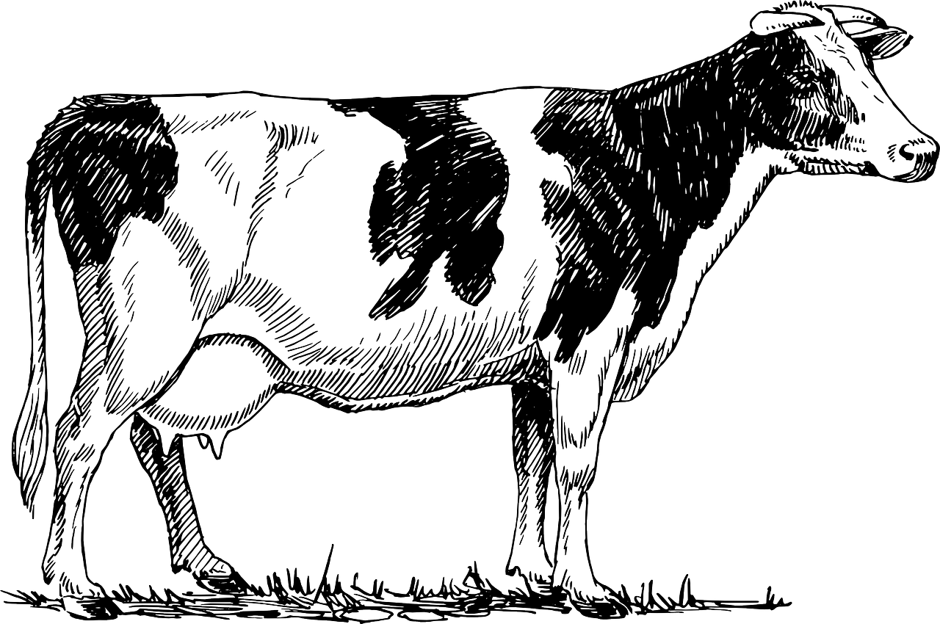
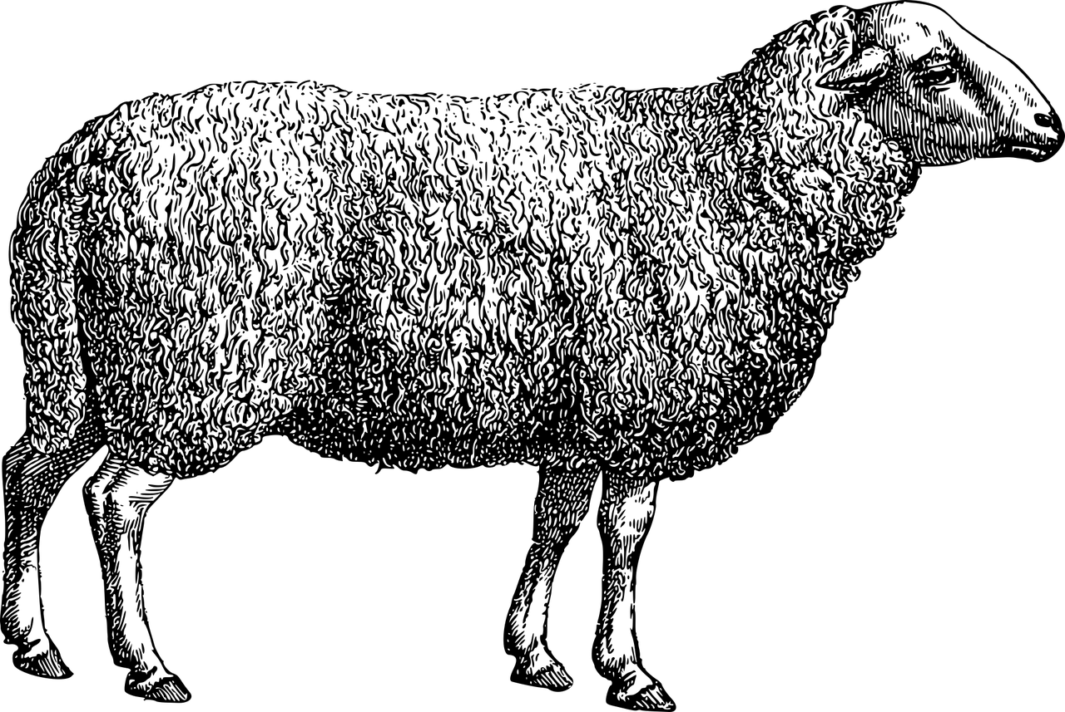

Slide 8
Here's your sheep

Slide 9
Here's your sheep
Here's your cows

Slide 10
Separate the sheep and cows
Where do you put the fence post to keep them separate?

Slide 14
Separate the sheep and cows
What if you want to add more sheep and/or cows later?
  You don't know how many of each
Where might you put the post?

Slide 16
Decision Boundary
COWS
SHEEP

Slide 17
Margin
Margin
Decision Boundary
COWS
SHEEP

Slide 18
Margin
Margin
Decision Boundary
COWS
Support Vector (Cow Closest to Fence)
SHEEP
Support Vector (Sheep Closest to Fence)

Slide 19
Support Vector Machine
Tries to classify data into categories
Tries to find a decision boundary that maximizes the margin between classes
Most "cushion" for new data (can put a new sheep in on the sheep side of the decision boundary)
We can use this separation in any dimension
  Line in 2D
  Plane in 3D
  N-1 something in ND

Slide 20
How does the SVM find this boundary?
Math

Slide 21
How does the SVM find this boundary?
Math
I'm serious I'm not going into it this time it uses LaGrange multipliers you guys

Slide 22
Linear Separability
A space is linearly separable if you can find this separating structure neatly

Slide 23
Margin
Margin
Decision Boundary
COWS
Support Vector (Cow Closest to Fence)
SHEEP
Support Vector (Sheep Closest to Fence)

Slide 24
Real World
On your farm, though, you have a recalcitrant sheep
Named Shaun
This is where Shaun likes to live:

Slide 25
Shaun

Slide 26
Real World
Clearly we can't use a simple fence post to separate the sheep and cows
Thanks Shaun
So what can we do?

Slide 27
Antigravity Cows
Let's add a dimension
Shaun can stay there
But let's make all our cows float

Slide 29
2D fence
Now we can separate our cows and sheep with a floating tarp!

Slide 31
2D fence
Everything above the tarp is a cow
Everything below the tarp is a sheep
They are separate!

Slide 32
Where are we going with this weird example
In classification, we want to easily separate our data into it's different classification categories based on feature dimensions
In the real world, our data, in however many dimensions it's in, is probably not super easy to separate linearly
So we use clever tricks to add additional dimensions where the data can be separated out
In this example, we had an anti-gravity ray that could tell sheep DNA from cow DNA

Slide 33
In Support Vector Machines
Most of the time, we use what's called a Kernel trick
When we want to project vectors into higher dimensional spaces, we use inner products
Kernel trick can get the transformations of inner products
I don't expect you to implement the linear algebra behind any of this

Slide 34
Just Know
That we make a clever transformation on our data to separate it out
We hope this clever transformation (which is usually some form of interaction of our features) can help us distinguish the classes
It's called the Kernel trick and it makes the SVM work
SVMs are fairly powerful and explainable models
They can sometimes even work on non-tabular data

Slide 35
To Recap
Projecting into higher dimensional spaces using linear combinations of features
We hope this creates a separation barrier between classes
Let's look at an even more silly example

Slide 36

Superheroes
What kind of superhero gets their own comic title?
You have to be:
  Compelling
Two types of hero (typically)
  Superhero with tons of powers but huge weakness (Green Lantern)
  Superhero with barely any powers but barely any weakness (Batman)
https://www.imdb.com/title/tt0059968/

Slide 37
Superhero "Dataset"
Superhero name
Power % (0-1, 0 not powerful, 1 very powerful)
Weakness % (0, huge weaknesses, 1, no weaknesses)
Standalone comic
  Y = Yes standalone Title
  N = No standalone Title

Slide 38
labels | power_percent | weakness_percent
Spiderman | 0.9 | 0.3
Superman | 1 | 0.1
Wolverine | 0.3 | 0.95
Batman | 0.01 | 1
Green Lantern | 0.9 | 0.1
Iron Man | 0.01 | 0.9
Hawkeye | 0.01 | 0.5
Black Widow | 0.01 | 0.5
Jean Grey | 0.5 | 0.4
Scott Summers | 0.7 | 0.6
Vision | 0.4 | 0.7
Green Arrow | 0.01 | 0.9

Slide 39
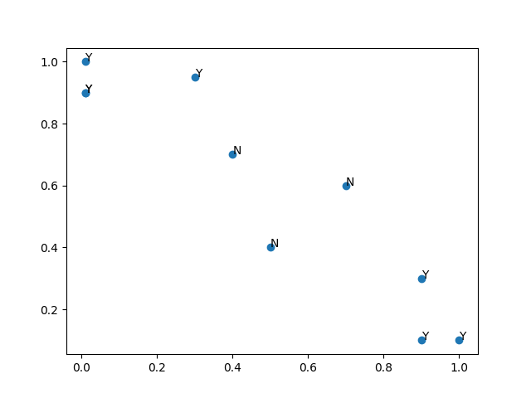
Not Linearly Separable!!!
Weakness Percent
Power Percent

Slide 40
We Know it's the Extremes
Low power, low weakness
High power, high weaknesses
Let's plot a transform
  (Power percent – 0.5)²
  Plot against power percent

Slide 41
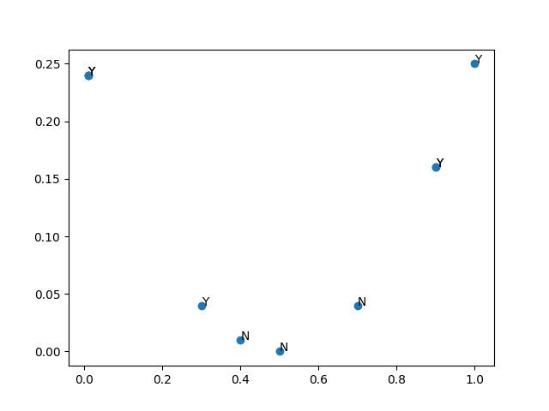
Linearly Separable
(Power-0.5)²
Power Percent

Slide 42
Linearly Separable
(Power percent-0.5)²
Power Percent

Slide 43
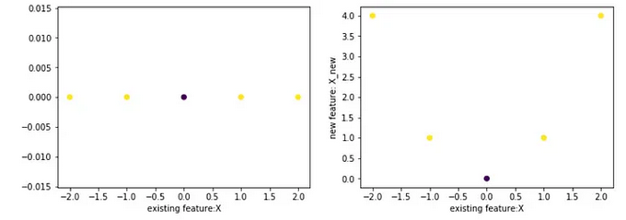
https://towardsdatascience.com/support-vector-machine-simply-explained-fee28eba5496

Slide 44
Radial Basis Function
RBF
Common for SVMs
Can tune with gamma parameter
Very popular

Slide 45
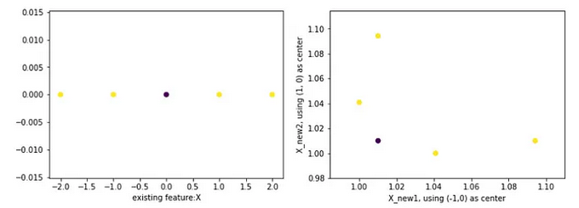
https://towardsdatascience.com/support-vector-machine-simply-explained-fee28eba5496

Slide 46
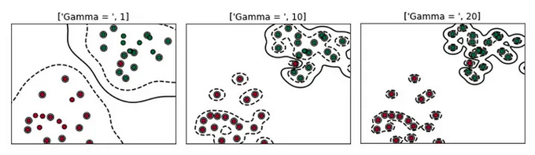
https://towardsdatascience.com/support-vector-machine-simply-explained-fee28eba5496

Slide 47
SVMs in ML
I see these a lot in the ag-focused ML papers I read
Not neural networks, but can be highly performant

Slide 48
PCA
Principal Component Analysis
Takes linear combinations of input vectors to retain information but reduce dimensions
Not super interpretable
Some similarities to our SVM process but different purpose
Just know linear combinations of inputs can generate some useful information for a machine learning model

Slide 49
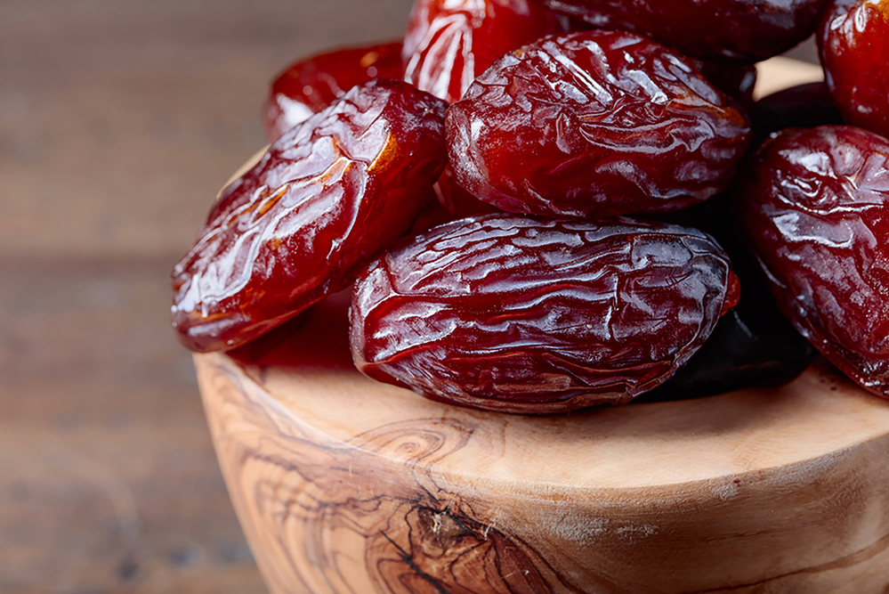
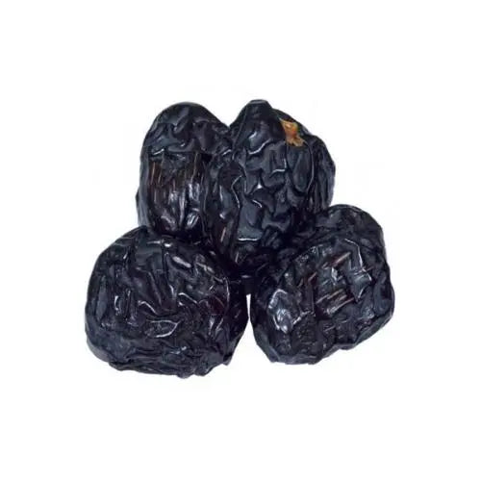
Let's Code an Example
Medjool vs Ajwa dates
Bati, G. (2023). Ajwa or Medjool [Dataset]. UCI Machine Learning Repository. https://doi.org/10.24432/C5K908.
Quite trivial – 20 examples total
Date length
Date Diameter
Date Weight
Pit Length
Calories
10 Ajwa, 10 Medjool
https://royalpalm-dates.com/product/medjool-dates/
https://www.khandryfruit.com/blogs/ajwa-dates-khajoor-health-benefits/ajwa-dates-khajoor-health-benefits-islamic-significance-and-culinary-delights

Slide 50
date_length | date_diameter | date_weight | pit_length | calories | color | class
3.2 | 2 | 12 | 2.2 | 41.28 | Black | Ajwa
3.5 | 1.8 | 11 | 1.9 | 37.84 | Black | Ajwa
3 | 1.7 | 9 | 2 | 30.96 | Black | Ajwa
3.1 | 2 | 10 | 1.9 | 34.4 | Black | Ajwa
2.8 | 1.8 | 9 | 1.9 | 30.96 | Black | Ajwa
3.1 | 1.9 | 12 | 2.2 | 41.28 | Black | Ajwa
3.2 | 2.2 | 13 | 1.9 | 44.72 | Black | Ajwa
3.1 | 1.7 | 12 | 2.1 | 41.28 | Black | Ajwa
3.6 | 2.5 | 9 | 2.7 | 30.96 | Black | Ajwa
3.8 | 1.8 | 10 | 1.9 | 34.4 | Black | Ajwa
4.4 | 2 | 14 | 2.9 | 44.24 | Brown | Medjool
5 | 1.4 | 15 | 2.5 | 47.4 | Brown | Medjool
5 | 1.7 | 15 | 2.1 | 47.4 | Brown | Medjool
5.2 | 1.4 | 17 | 2.6 | 53.72 | Brown | Medjool
5 | 2 | 17 | 2 | 53.72 | Brown | Medjool
4.2 | 1.6 | 14 | 2.3 | 44.24 | Brown | Medjool
5.1 | 2.1 | 16 | 2.7 | 50.56 | Brown | Medjool
4.2 | 1.8 | 16 | 2.3 | 50.56 | Brown | Medjool
4.6 | 1.7 | 13 | 2.7 | 41.08 | Brown | Medjool
5 | 2.4 | 19 | 2.8 | 60.04 | Brown | Medjool

Slide 51
ML
Dataset
Type of Machine Learning
Data Split
Model Evaluation

Slide 52
ML
Dataset
  Dates. Classification Task
Type of Machine Learning
Data Split
Model Evaluation

Slide 53
ML
Dataset
  Dates. Classification Task
Type of Machine Learning
  Supervised
Data Split
Model Evaluation

Slide 54
ML
Dataset
  Dates. Classification Task
Type of Machine Learning
  Supervised
Data Split
  Try 10% maybe
Model Evaluation

Slide 55
ML
Dataset
  Dates. Classification Task
Type of Machine Learning
  Supervised
Data Split
  Try 10% maybe
Model Evaluation
  Accuracy

Slide 56
Questions?

